Slide 1


LOGISTICS OF CREATING A MARINE TACTICAL LIVE FIRE TRAINING PROGRAM
SEPTEMBER 11, 2017
NASBLA ANNUAL CONFERENCE
RAPID CITY, SOUTH DAKOTA
PRESENTATION BY:
MAJOR DAN HESKET
KANSAS WILDLIFE, PARKS & TOURISM
LAW ENFORCEMENT DIVISION
Notes:
PRESENTATION IS GENERALIZED TO BE FIT INTO ANY AGENCIES PROGRAM; NOT TACTICS RELATED; START WITH AN IDEA-IDEA WAS TO PROVIDE REALITY BASED ON FIRING WEAPONS FROM
PATROL BOATS IN REAL LIFE SITUATIONS.

Slide 2
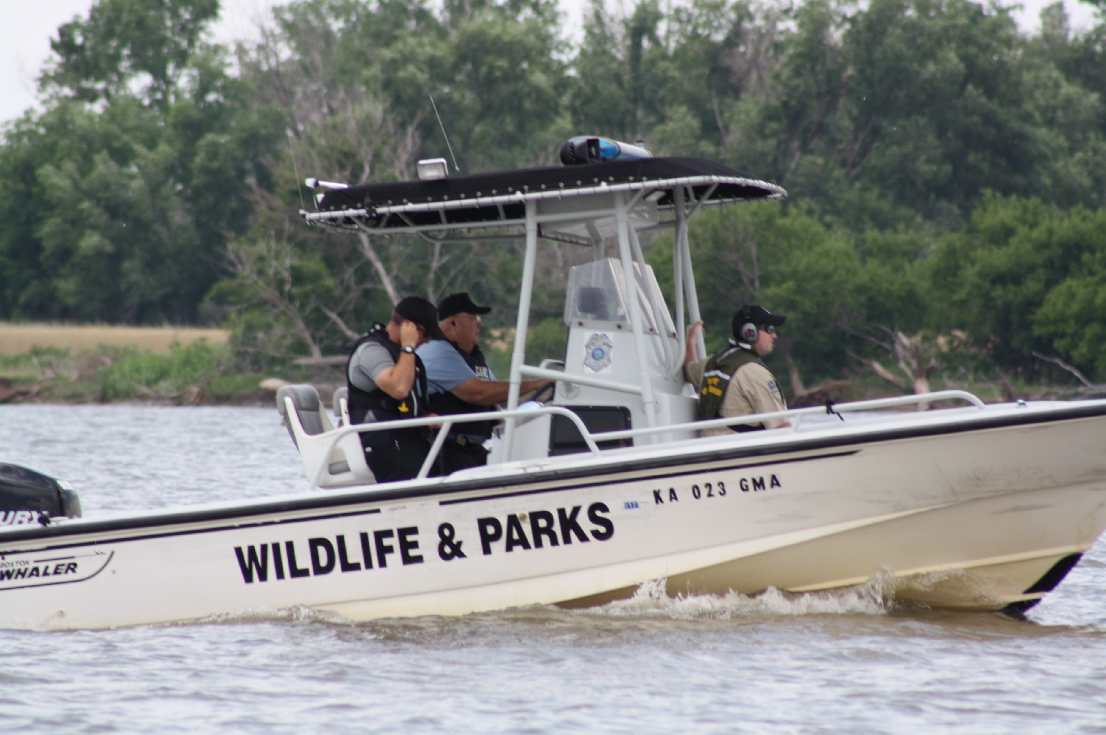



Notes:
ASK THE QUESTION- WHAT IS IT YOU WANT TO ACCOMPLISH, DO THE RESEARCH,

Slide 3
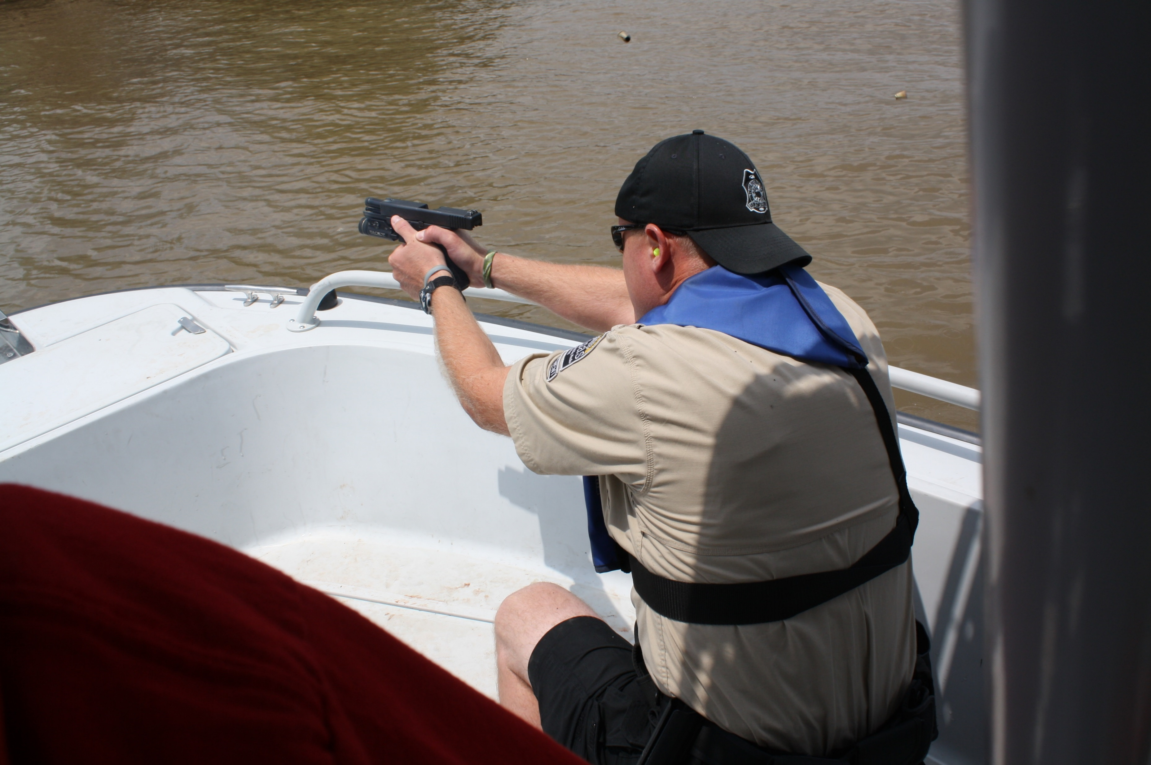


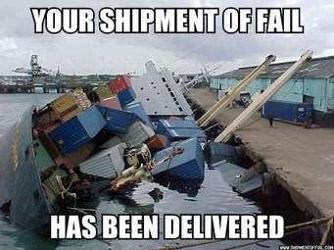

AGENCY SUPPORT IN WRITING
Notes:
RESEARCH DEPARTMENT POLICY AND PROCEDURES, STATE AND FEDERAL LAWS, GAIN SUPPORT FROM AGENCY SUPERIORS (FINANCIAL) AND CONCENTRATE ON SAFETY.

Slide 4
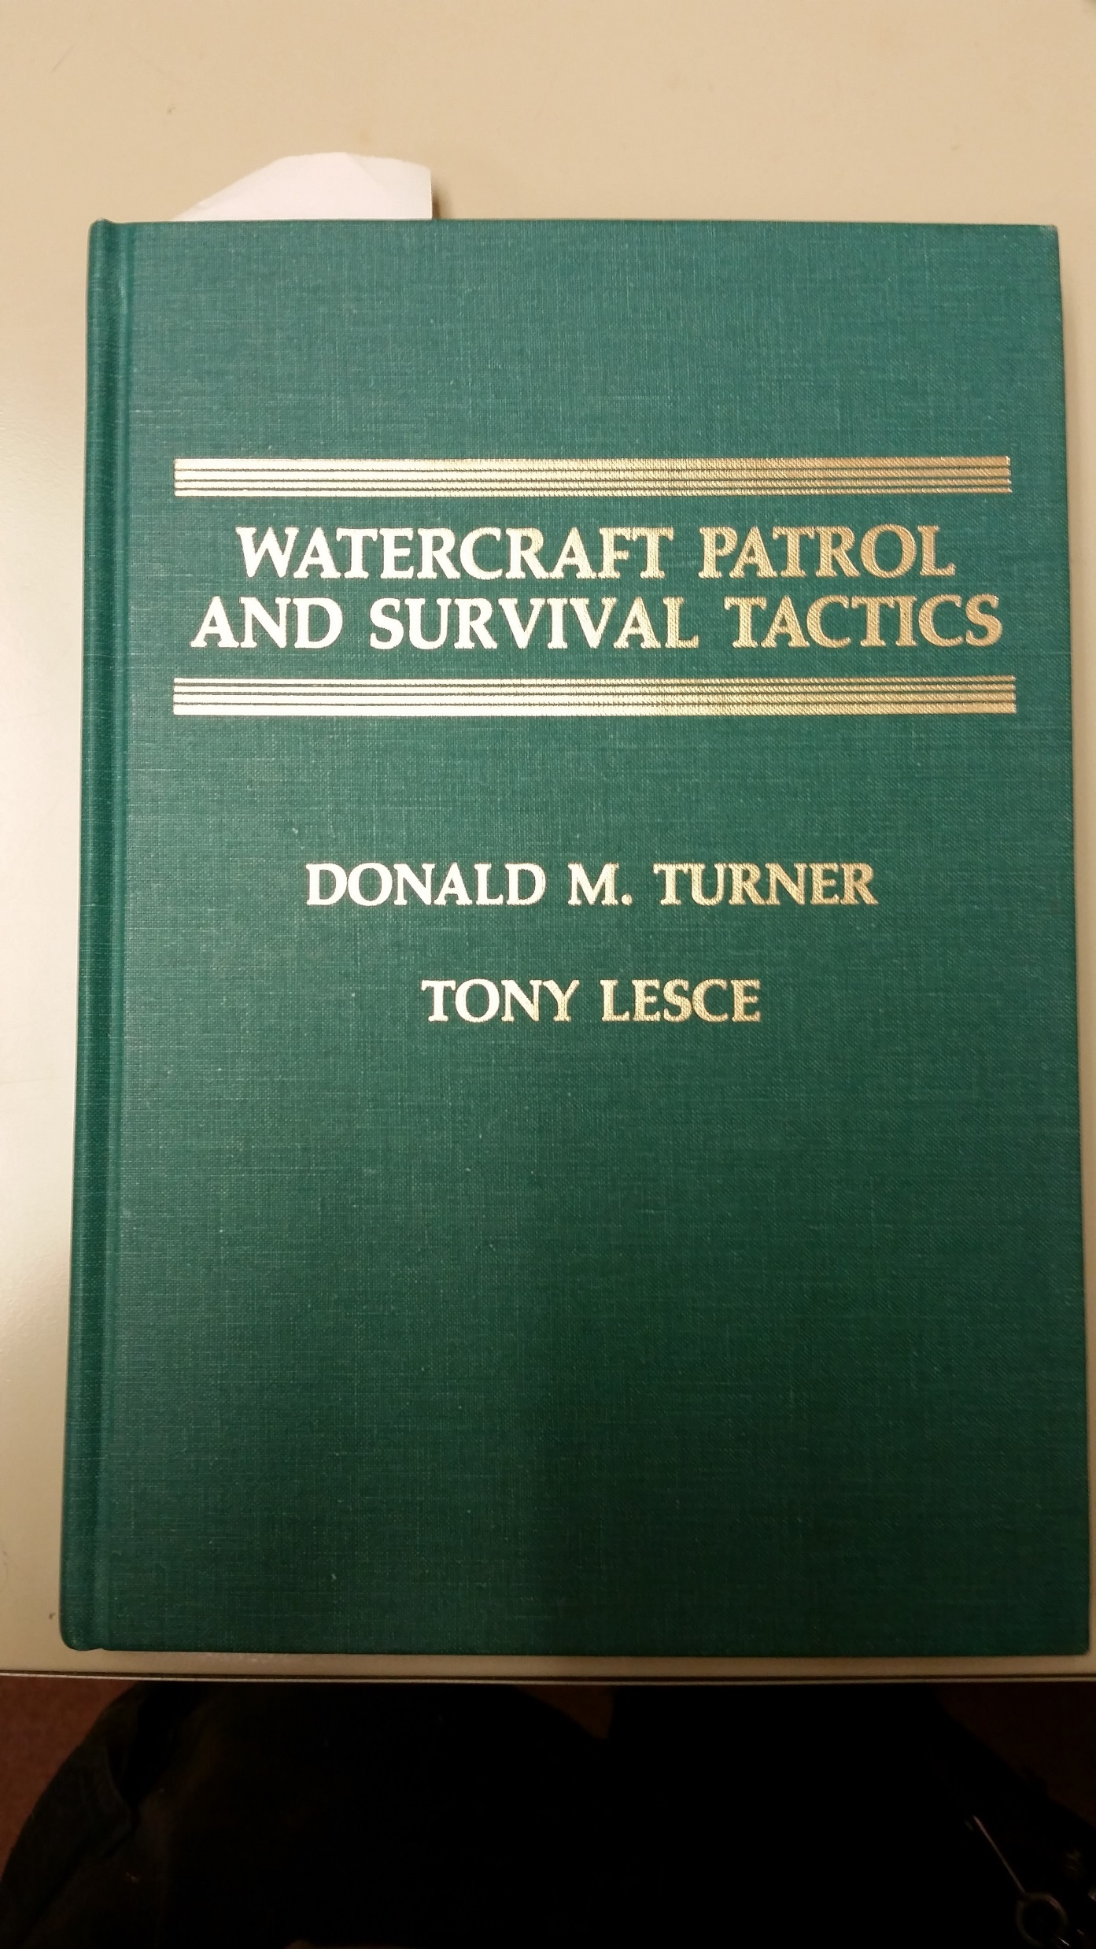
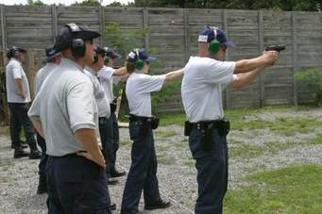
1998
Notes:
RESEARCH BEGIN IN 1998 AS A FIELD OFFICER, READING BOOK AND NETWORKING WITH INDIVIDUALS FROM OTHER STATES IN ATTENDING IAMI AND IBWSS CONFERENCES/ BEGIN SMALL WITH BOATS ON TRAILERS TO INNERTUBES.

Slide 5

2003
Notes:
2003 AFTER 2 YEARS OF PLANNING CONDUCTED TRAINING WITH OKLAHOMA’S LAKE PATROL UNIT FIREARMS INSTRUCTORS.

Slide 6

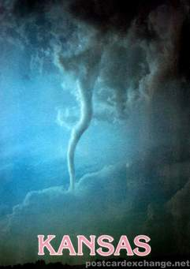
WILSON RESERVOIR – U.S. ARMY CORP OF ENGINEER RESERVOIR
PERMISSION ACQUIRED FOR LIVE SHOOT AND SHUTTING OFF PUBLIC ACCESS
9,045 ACRES OF PUBLIC WATER
3 T0 4 MILES TO NEAREST RESIDENCE
LIVE FIRE SITE – ROCK CITY COVE – TALL BLUFFS; NO PUBLIC ACCESS ON FOOT
WEATHER AND WINDS (TIME OF YEAR)
HOT ZONE PATROLLED BY LE BOATS TO KEEP PUBLIC BOATS OUT. NO BOAT BUOYS PLACED
STAGING AND LAUNCHING AREA – MINOOKA BOAT RAMP SITE
Notes:
BIGGEST PART OF LOGISTICS IS FINDING A PLACE TO CONDUCT THE TRAINING. SAFETY SAFETY AND SAFETY. ADAPT TO SIMUNITIONS; AIR SOFT; ETC.

Slide 7
CONSIDERATIONS
WHAT WILL YOUR AGENCY ALLOW YOU TO DO ?
COOPERATING AGREEMENTS WITH OTHER AGENCIES; ARMY CORP, COUNTY, CITY, OTHER AGENCY TRAINERS.
WHAT NUMBER OF OFFICERS ARE YOU PLANNING TO TRAIN?
WHAT IS YOUR BUDGET !!!
WHAT RESOURCES DO YOU NEED?
DON’T FORGET TO INCLUDE OFFICER TIME AND INSTRUCTORS – OVERTIME CONSIDERATIONS!
KEEPING THE PUBLIC INFORMED.
Notes:
7 MAIN POINTS TO COVER

Slide 8
WHAT WILL YOUR AGENCY ALLOW YOU TO DO?
DOUBLE CHECK YOUR POLICIES AND OPERATING PROCEDURES TO ASSURE YOU CAN DO WHAT YOU PLAN BEFORE INVESTING THE TIME INTO IT.
CONTACT OTHER AGENCIES THAT HAVE DONE SOMETHING AND USE THEIR INFORMATION AS A TEMPLATE.
IF USING YOUR OWN DEPARTMENT CONTROLLED AREAS, ARE THEIR OTHER DIVISIONS THAT NEED TO BE BROUGHT IN TO ACCOMPLISH YOUR TASK:
CLOSING OFF PUBLIC ACCESS BY ROAD TO AREAS IN THE HOT ZONE.
PROVIDING MAN POWER.
PROVIDING EQUIPMENT.
BRUSH CONTROL OR CLEARING OF AN AREA FOR TARGETS, ETC.
IF OTHER DIVISION PERSONNEL COMPLAIN IT HAS A CHANCE TO SHUT DOWN YOUR OPERATIONS!!
GUIDELINES TO FOLLOW FOR TRASH REMOVAL, DISPOSAL OF SHOT UP BOATS (COST), ANY ISSUE WITH LEAD CLEAN-UP FROM THE SHOOTING AREA (THIS MAY PREVENT AN ACTUAL LIVE FIRE SITUATION).
WILL YOUR AGENCY ALLOW YOU TO PROVIDE FOOD AND DRINKS DURING THE TRAINING (CONTRACT ITEMS)?

Slide 9
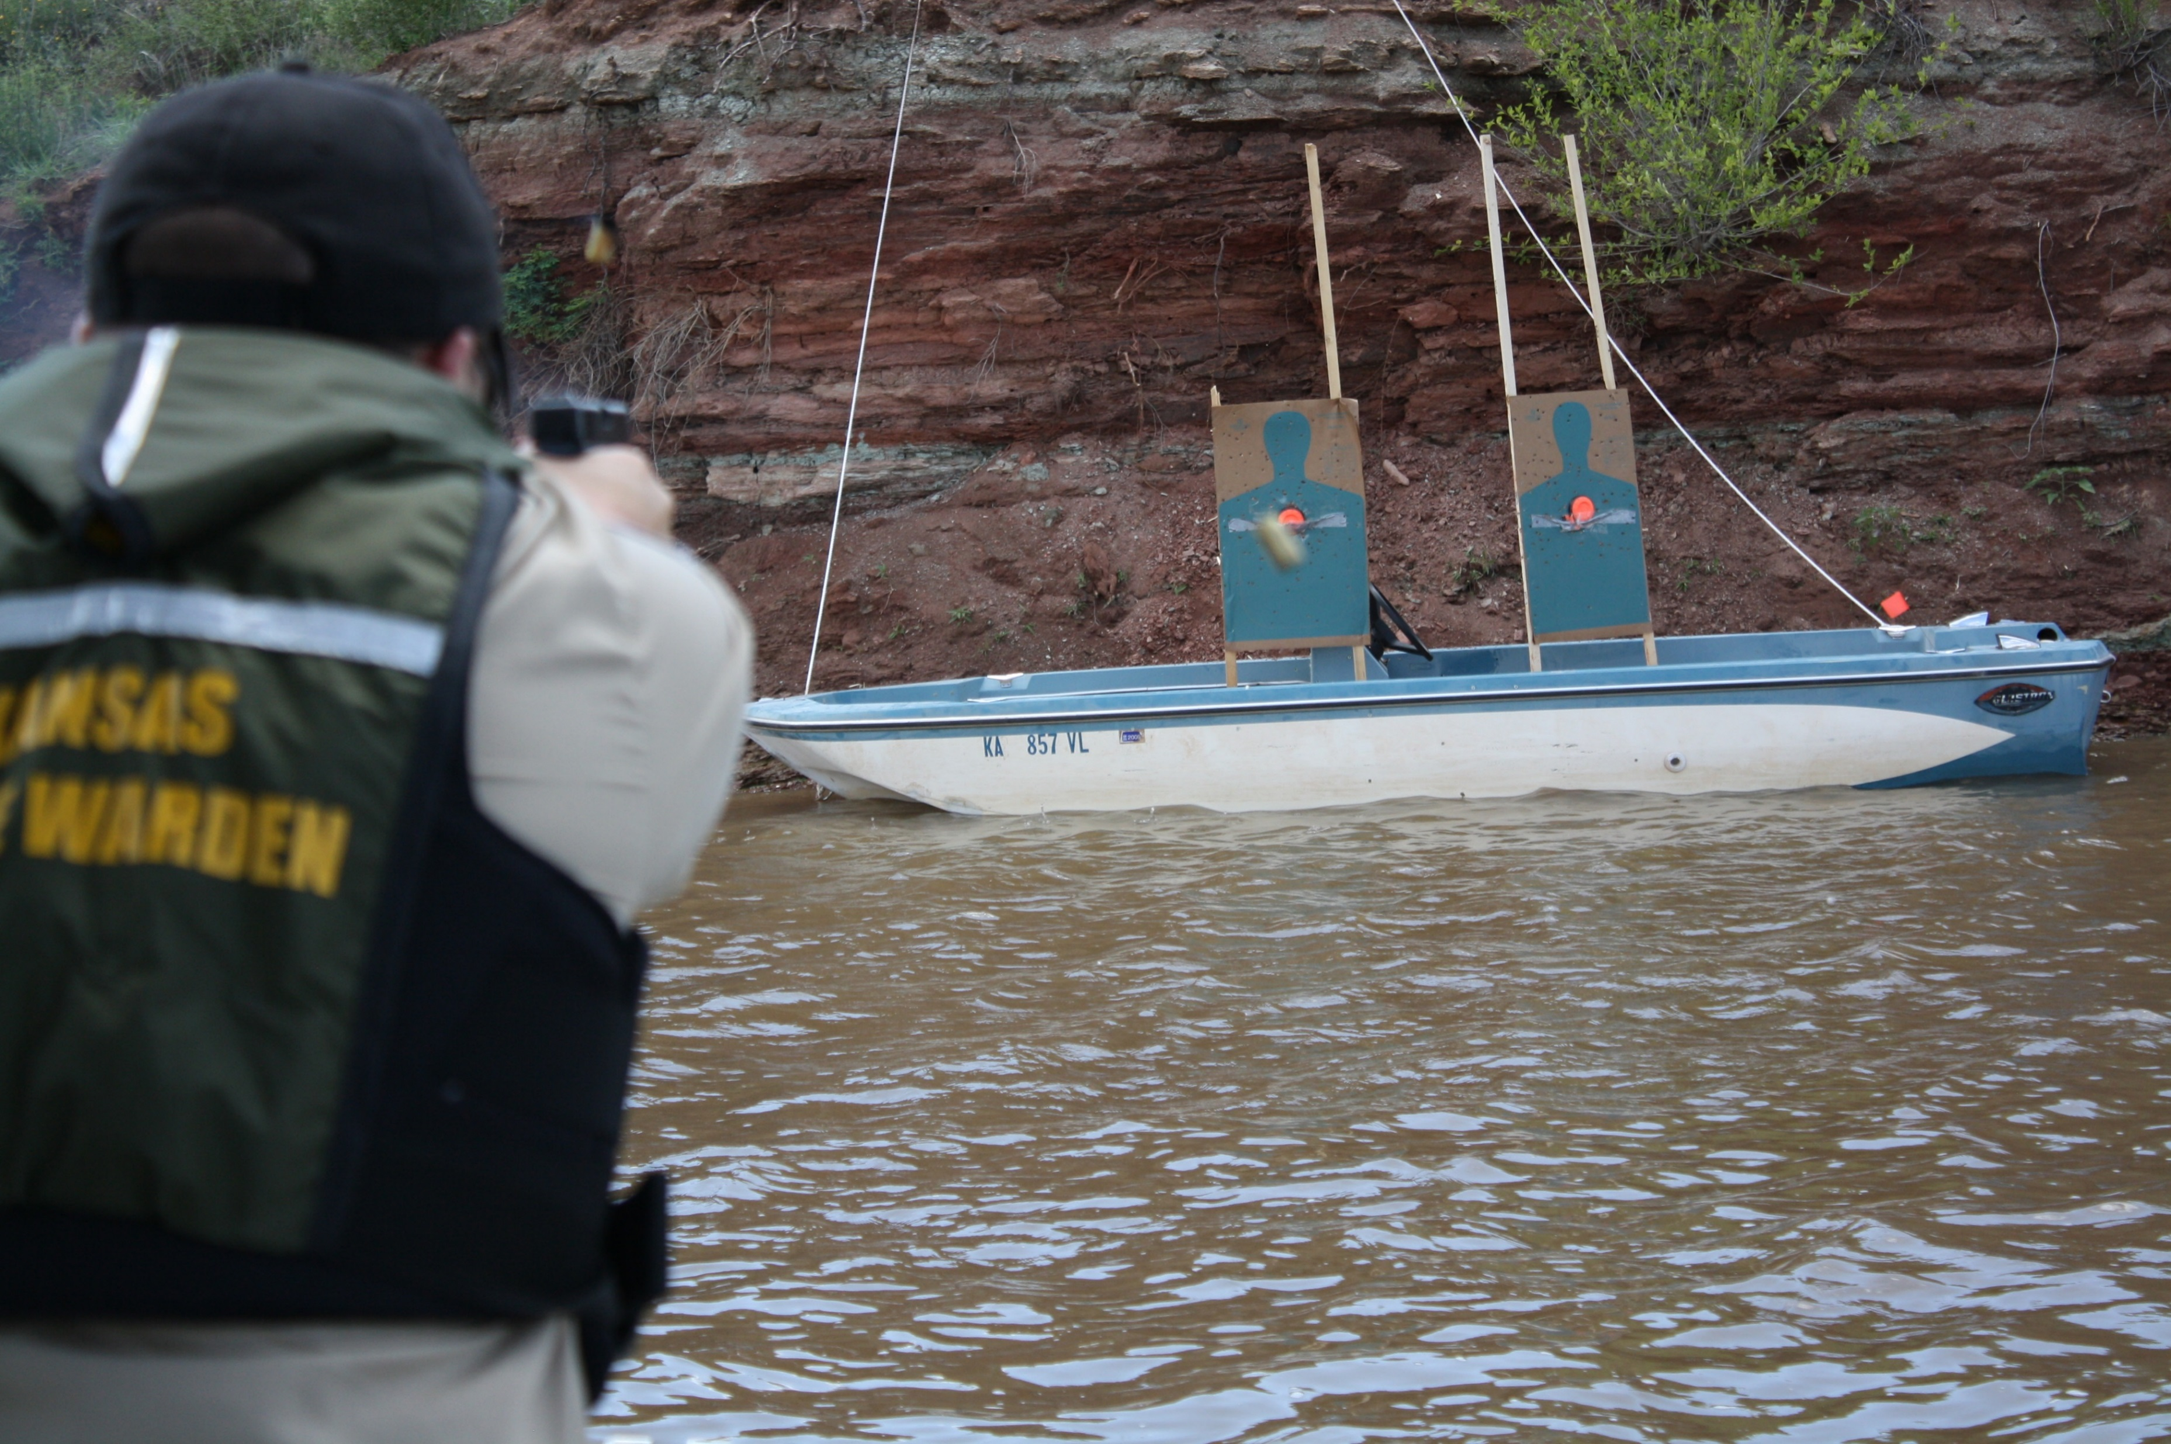
AGREEMENT WITH THE COUNTY LANDFILL TO DUMP THE USED, VERY SHOT UP BOATS AT NO COST WHEN DONE.

Slide 10
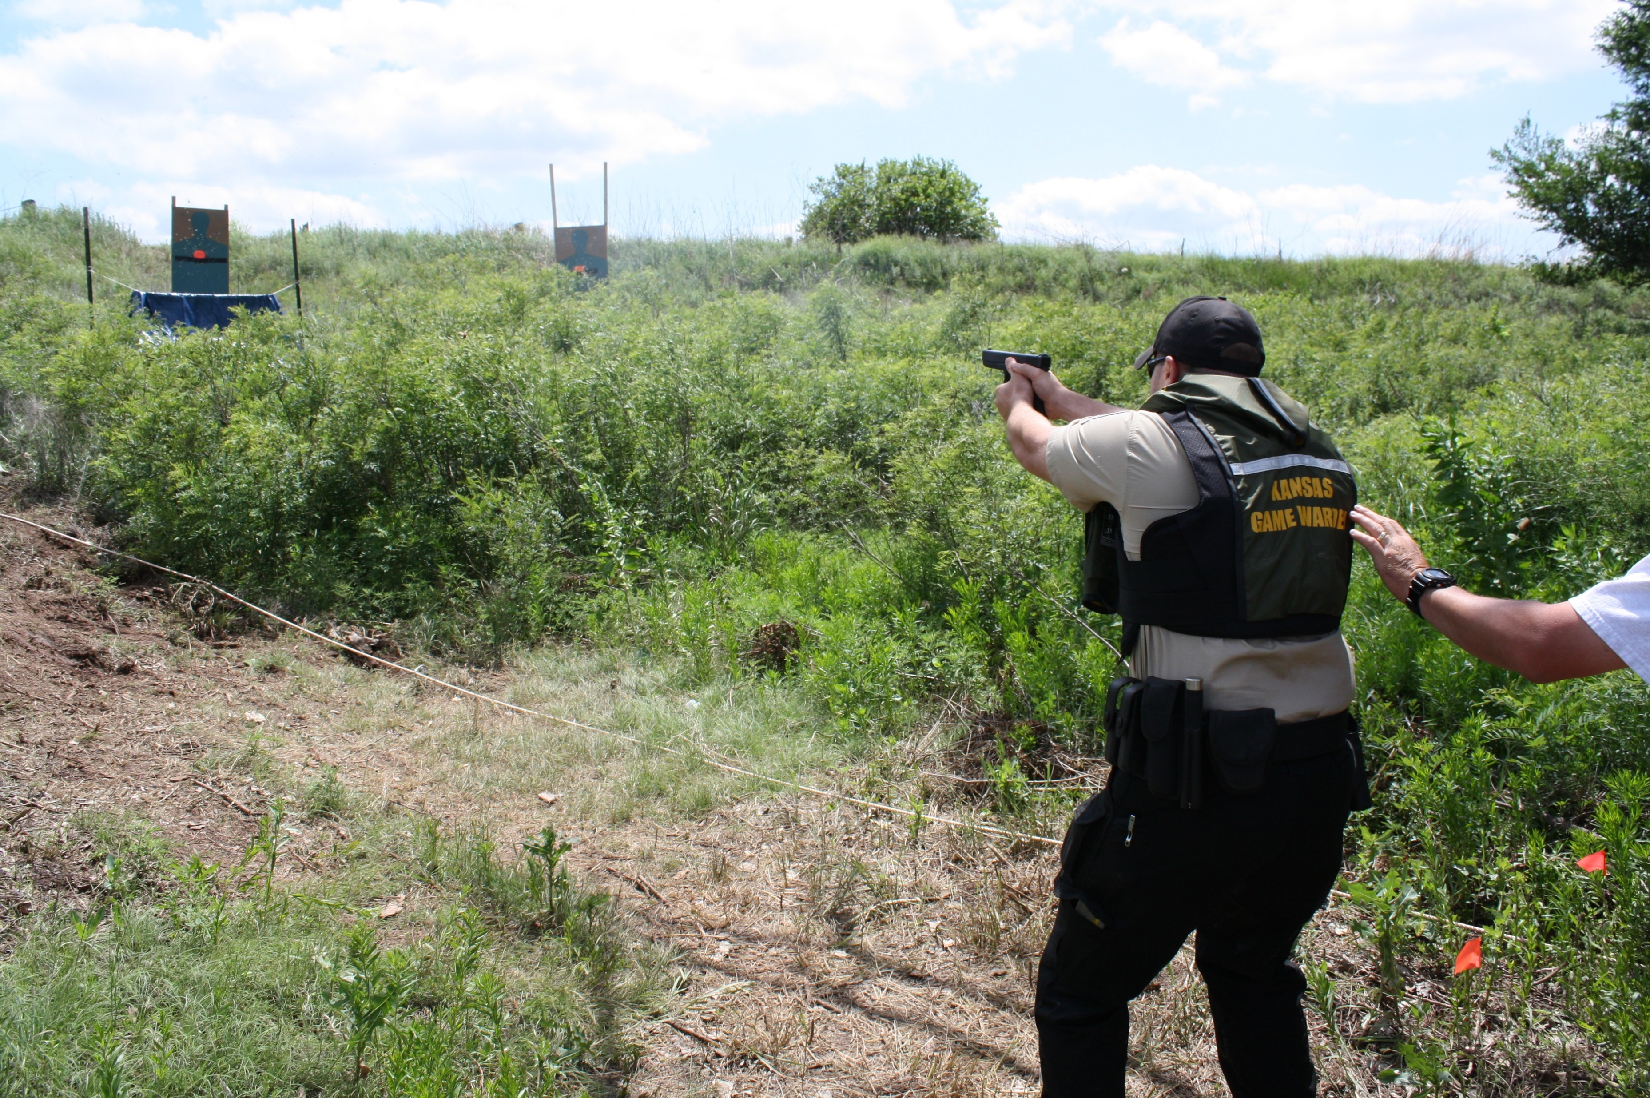
CHENEY RESERVOIR SHOOT – 2014; ADDED A CAMPSITE CHECK AND RUNNING DOG STATION REQUIRING CLEARING BRUSH ON THE WILDLIFE AREA AS WELL AS AN AREA TO BEACH THE BOAT AND OFFICERS TO OFF-LOAD. WORKED WITH WILDLIFE AREA MANAGER.
Notes:
PERMISSION TO ALTER AN AREA IN WILDLIFE AREA, PICK UP BRASS, ETC.

Slide 11
COOPERATING AGREEMENTS WITH OTHER AGENCIES; ARMY CORP, COUNTY, CITY, OTHER AGENCY TRAINERS.
LARGER RESERVOIRS IN OUR STATE ARE EITHER ARMY CORP OR BUREAU OF RECLAMATION LAKES
WILSON RESERVOIR IN 2003 IS AN ARMY CORP. RESERVOIR
CHENEY RESERVOIR IN 2014 AND 2015 IS A BUREAU OF REC. LAKE
SMALLER TRAINING SHOOTS HAVE BEEN CONDUCTED AT STATE FISHING LAKES
THESE ARE OWNED AND RAN BY OUR AGENCY
ANOTHER CONSIDERATION
DO YOU BRING ALL THE OFFICERS TO ONE LOCATION, OR DO YOU BREAK IT UP AND DO MORE REGIONAL TYPE OF TRAINING EVENTS??
Notes:
MAY REQUIRE AN MOU, AGREEMENT, CONTRACT

Slide 12
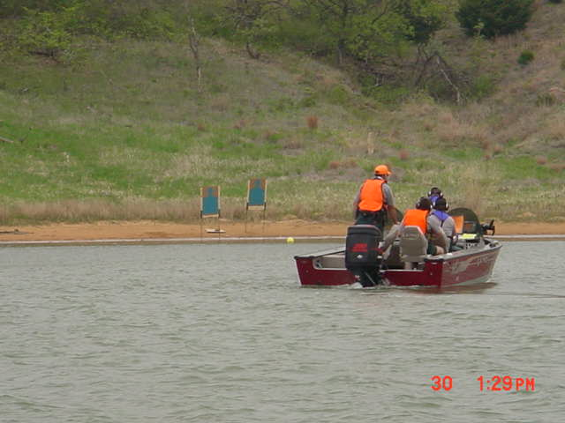
WILSON RESERVOIR
2003
KDWPT TRAINING WITH OKLAHOMA WATER PATROL FIREARMS INSTRUCTORS
Notes:
PROGRESSION OF EQUIPMENT; DON’T STAY STATIC; DEVELOP; CHALLENGE; REDESIGN.

Slide 13
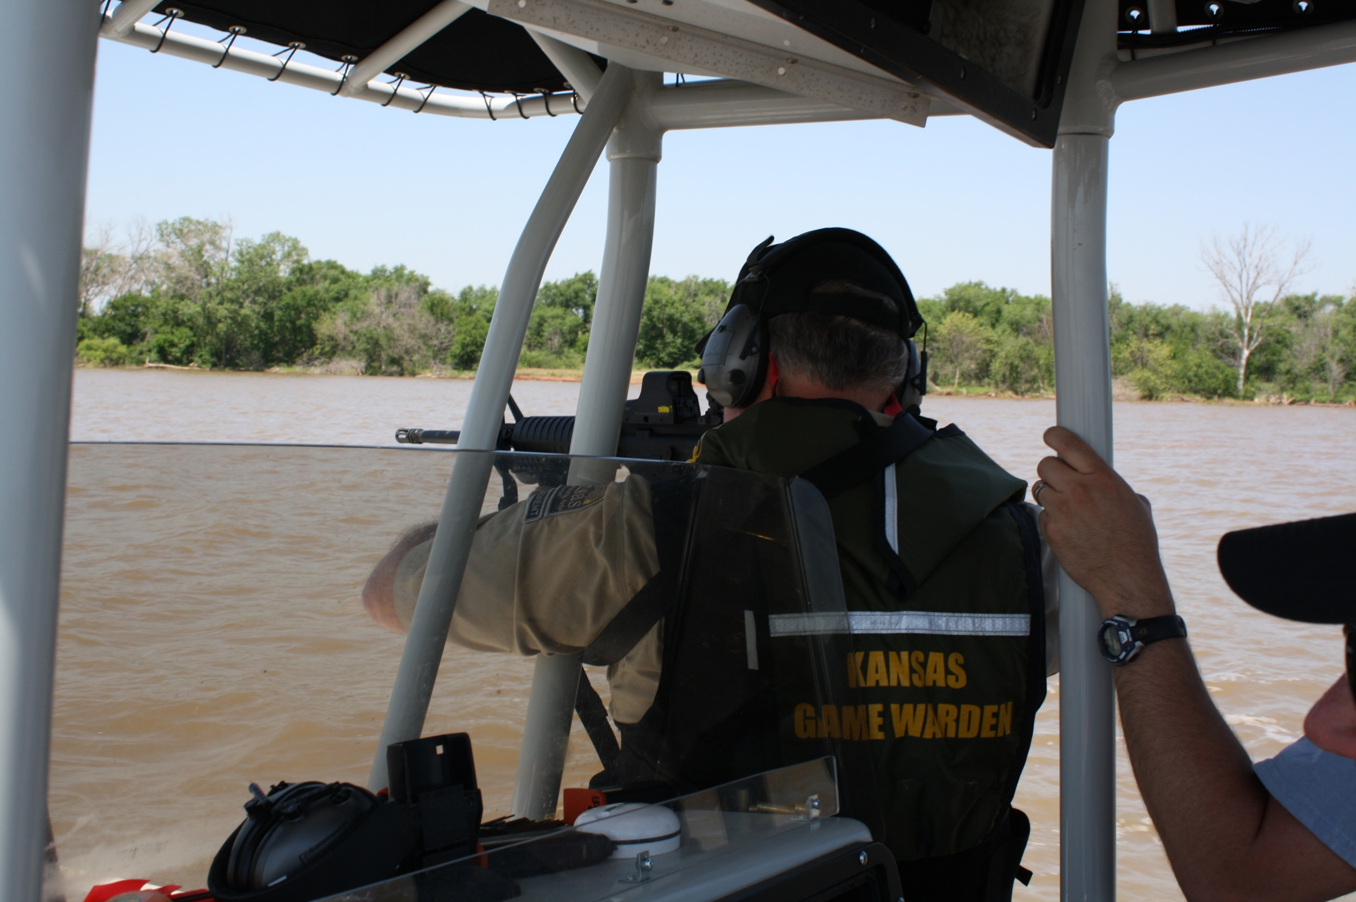
2014 – CHENEY RESERVOIR
4 DAYS; 135 OFFICERS RAN THROUGH THE COURSE OF FIRE
7 STATIONS
Notes:
135 COMMISSIONE OFFICER FROM 3 DIVISIONS, PARKS (PARK RANGERS), PUBLIC LANDS (LAND MANAGERS), LAW ENFORCEMENT (GAME WARDENS) WHO IS YOUR BACKUP, HOW DO YOU PATROL 1 OR 2 MAN TEAMS, CHALLENGES OF TRAINING ACROSS CHAIN OF COMMANDS.

Slide 14
WHAT NUMBER OF OFFICERS ARE YOU PLANNING TO TRAIN?
BRING THEM ALL IN TOGETHER AT THE SAME TIME.
WHAT WILL YOU DO WITH THEIR DOWN TIME?
DRIVE TIME FOR THEM TO AND FROM THE TRAINING SITE?
WILL IT REQUIRE HOTELS AND PER DIEM COST? (BUDGET)
ROTATE THEM IN THEIR SMALL GROUPS TO RUN THE COURSE AND LEAVE.
REQUIRES SOME SERIOUS SCHEDULING.
REDUCES THE NEED FOR OVERNIGHT AND PER DIEM COST?
WILL COMPLAIN THEY DRIVE SO FAR FOR A 1 HOUR TRAINING SESSION !!
BOTH SYSTEMS HAVE WORKED !!!!

Slide 15
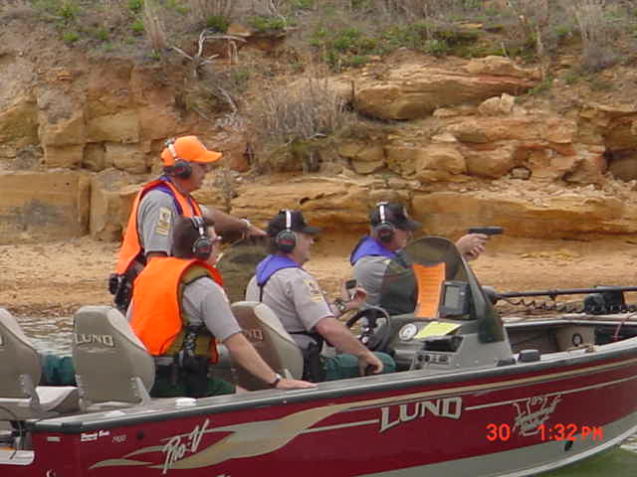
WILSON SHOOT 2013, TRAINING OFFICERS AND OKLAHOMA OFFICERS MET, SET UP COURSE AND DID TRIAL RUNS ON FIRST DAY.
THAT EVENING THE FIRST GROUP OF 30 ARRIVED AND CHECKED INTO HOTEL, NEXT DAY RAN THROUGH THE COURSE AND LEFT. 2ND GROUP ARRIVED THAT EVENING AND CHECKED INTO HOTEL, RAN THE COURSE ON THE 3RD DAY………..ETC.
WHILE WAITING TO RUN THE COURSE THE OTHER OFFICERS WENT THROUGH A ROTATION OF TRAINING STATIONS AT THE STAGING AREA SUCH AS DEFENSIVE TACTICS DRILLS, HANDCUFFING A SUSPECT ON A BOAT, LIFE JACKET PLACEMENT ON A SUSPECT ON A BOAT, ETC.

Slide 16
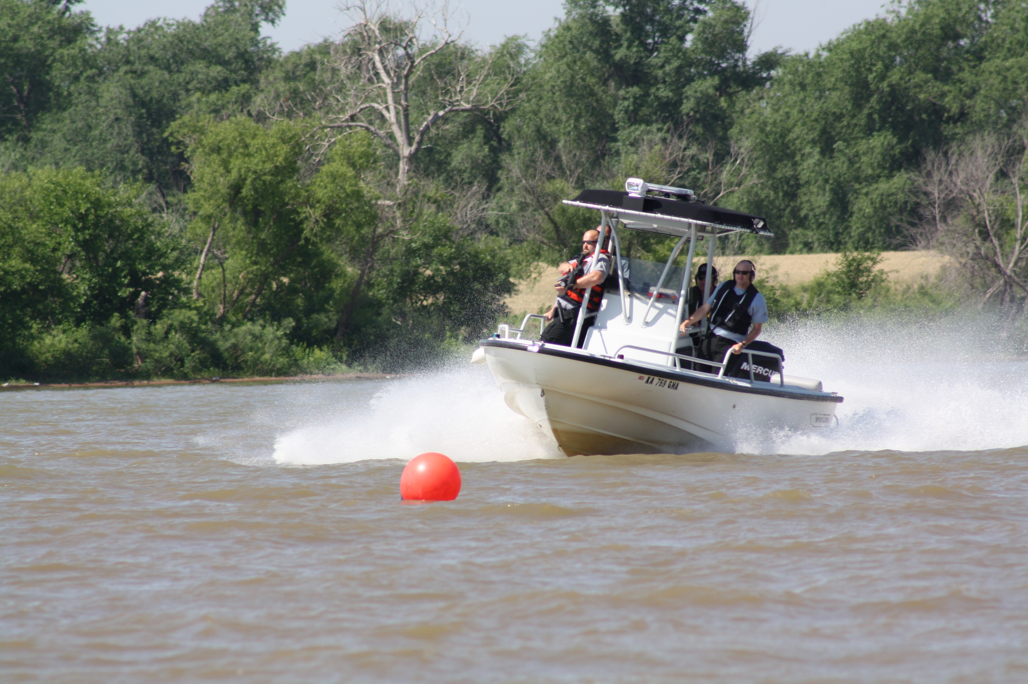
2014; OFFICERS ARRIVED BY SCHEDULE, 3 AT A TIME ON THE 1/2 HOUR, RUNNING 30 OFFICERS A DAY FOR 4 DAYS. THEY WOULD RUN THE COURSE AND LEAVE. OFFICERS STAGED UP FOR NEXT RUN WOULD BE ISSUED AMMO, GIVEN A SAFETY TALK, HAVE THE OPERATIONS OF THE COURSE EXPLAINED TO THEM AND SECURE THEIR LIFE JACKETS.
Notes:
NOTICE CHANGE OF OUR EQUIPMENT???

Slide 17
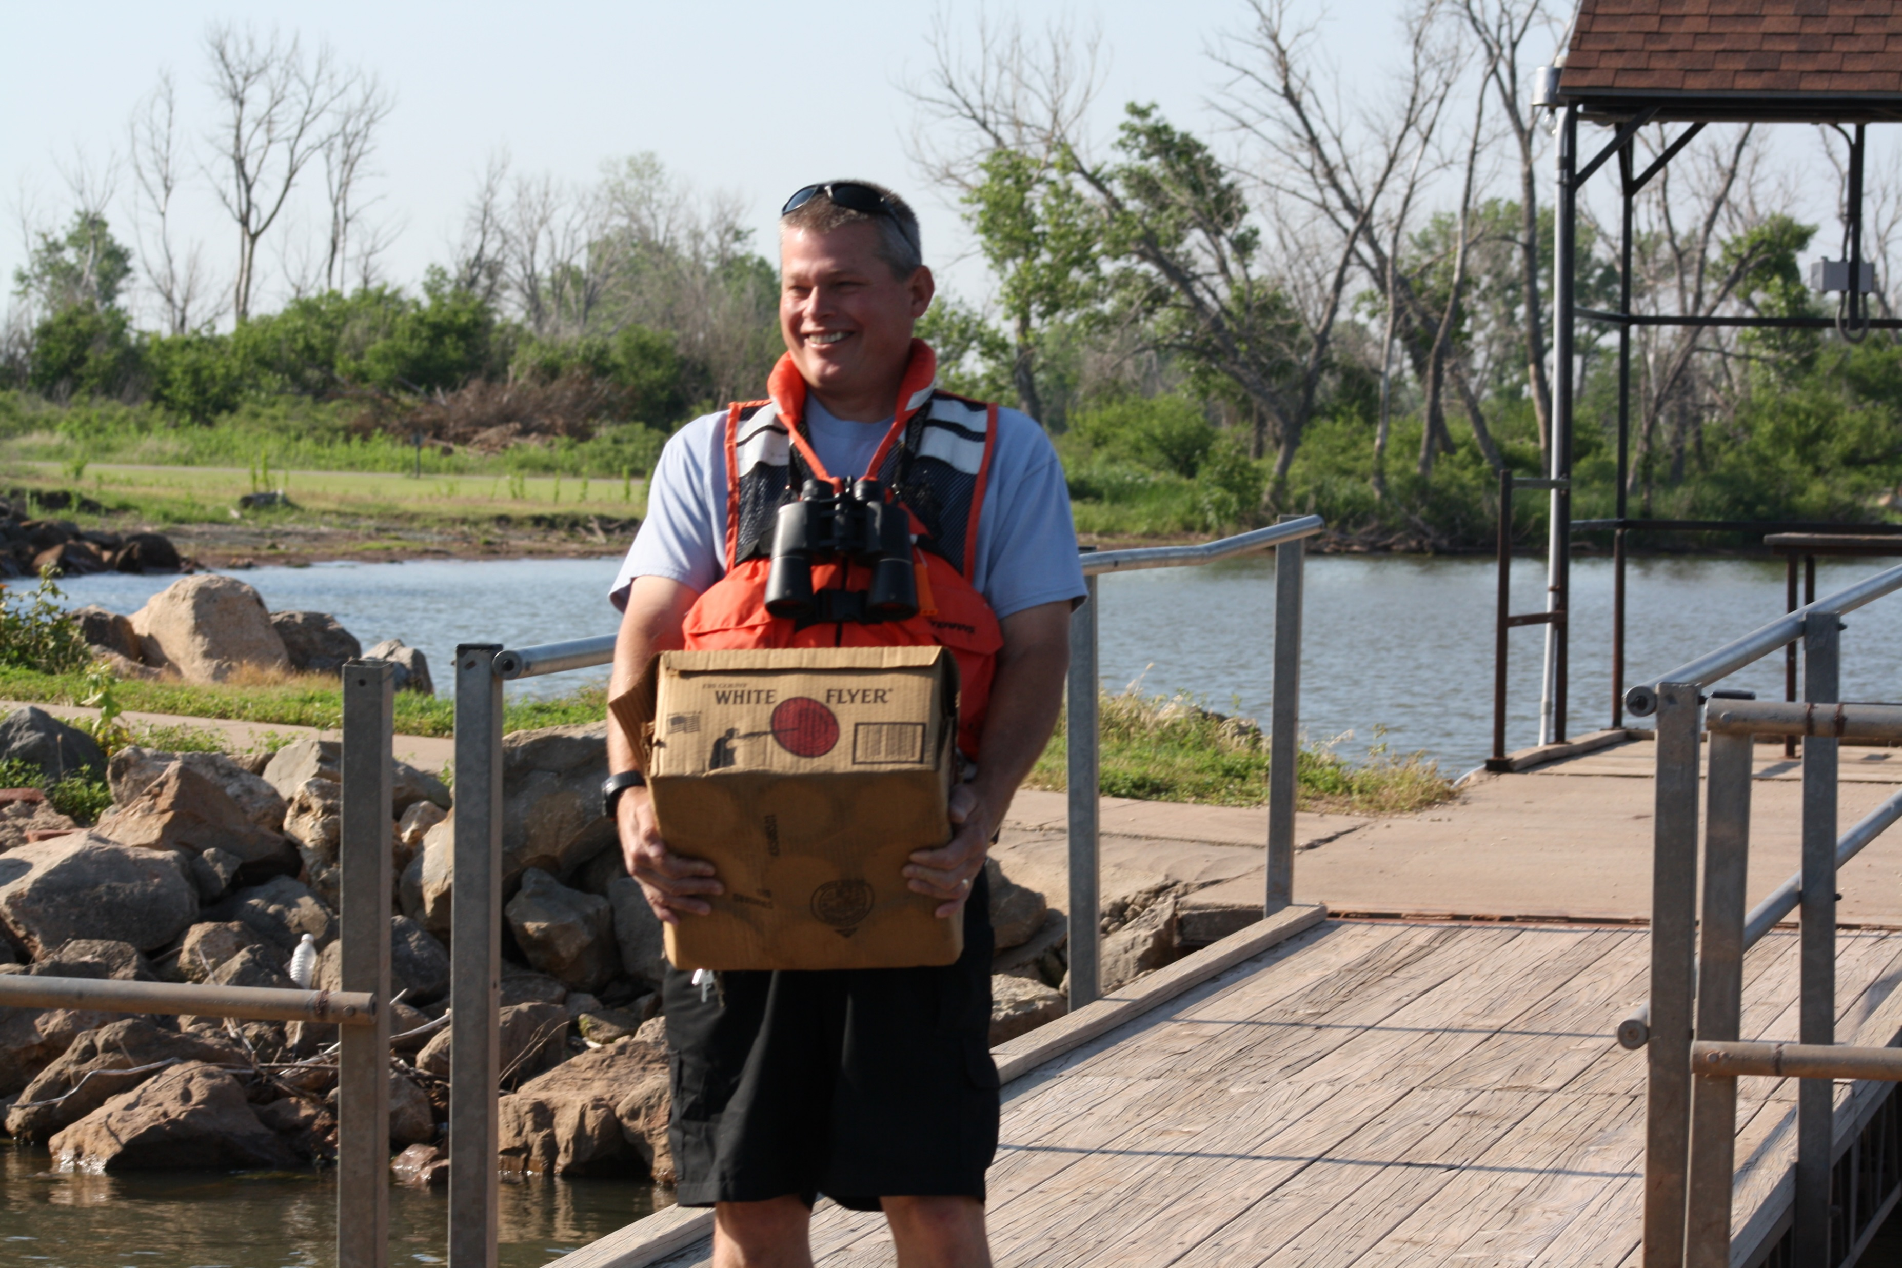
WHAT IS YOUR BUDGET !!!
HIGH TECH VS. LOW TECH TARGET SYSTEMS!!!!
WHAT OVERTIME !!!!
ROOM AND BOARD COST
EQUIPMENT COST
AMMUNITION COST
DAMAGES !!!!
Notes:
LOSS OF MAGAZINES OVER BOARD, PERSONNAL INJURIES FROM MOVING EQUIPMENT, ETC., CLEANING FIREARMS (IS A RANGE SHOOT; TAKES SUPPLIES)

Slide 18
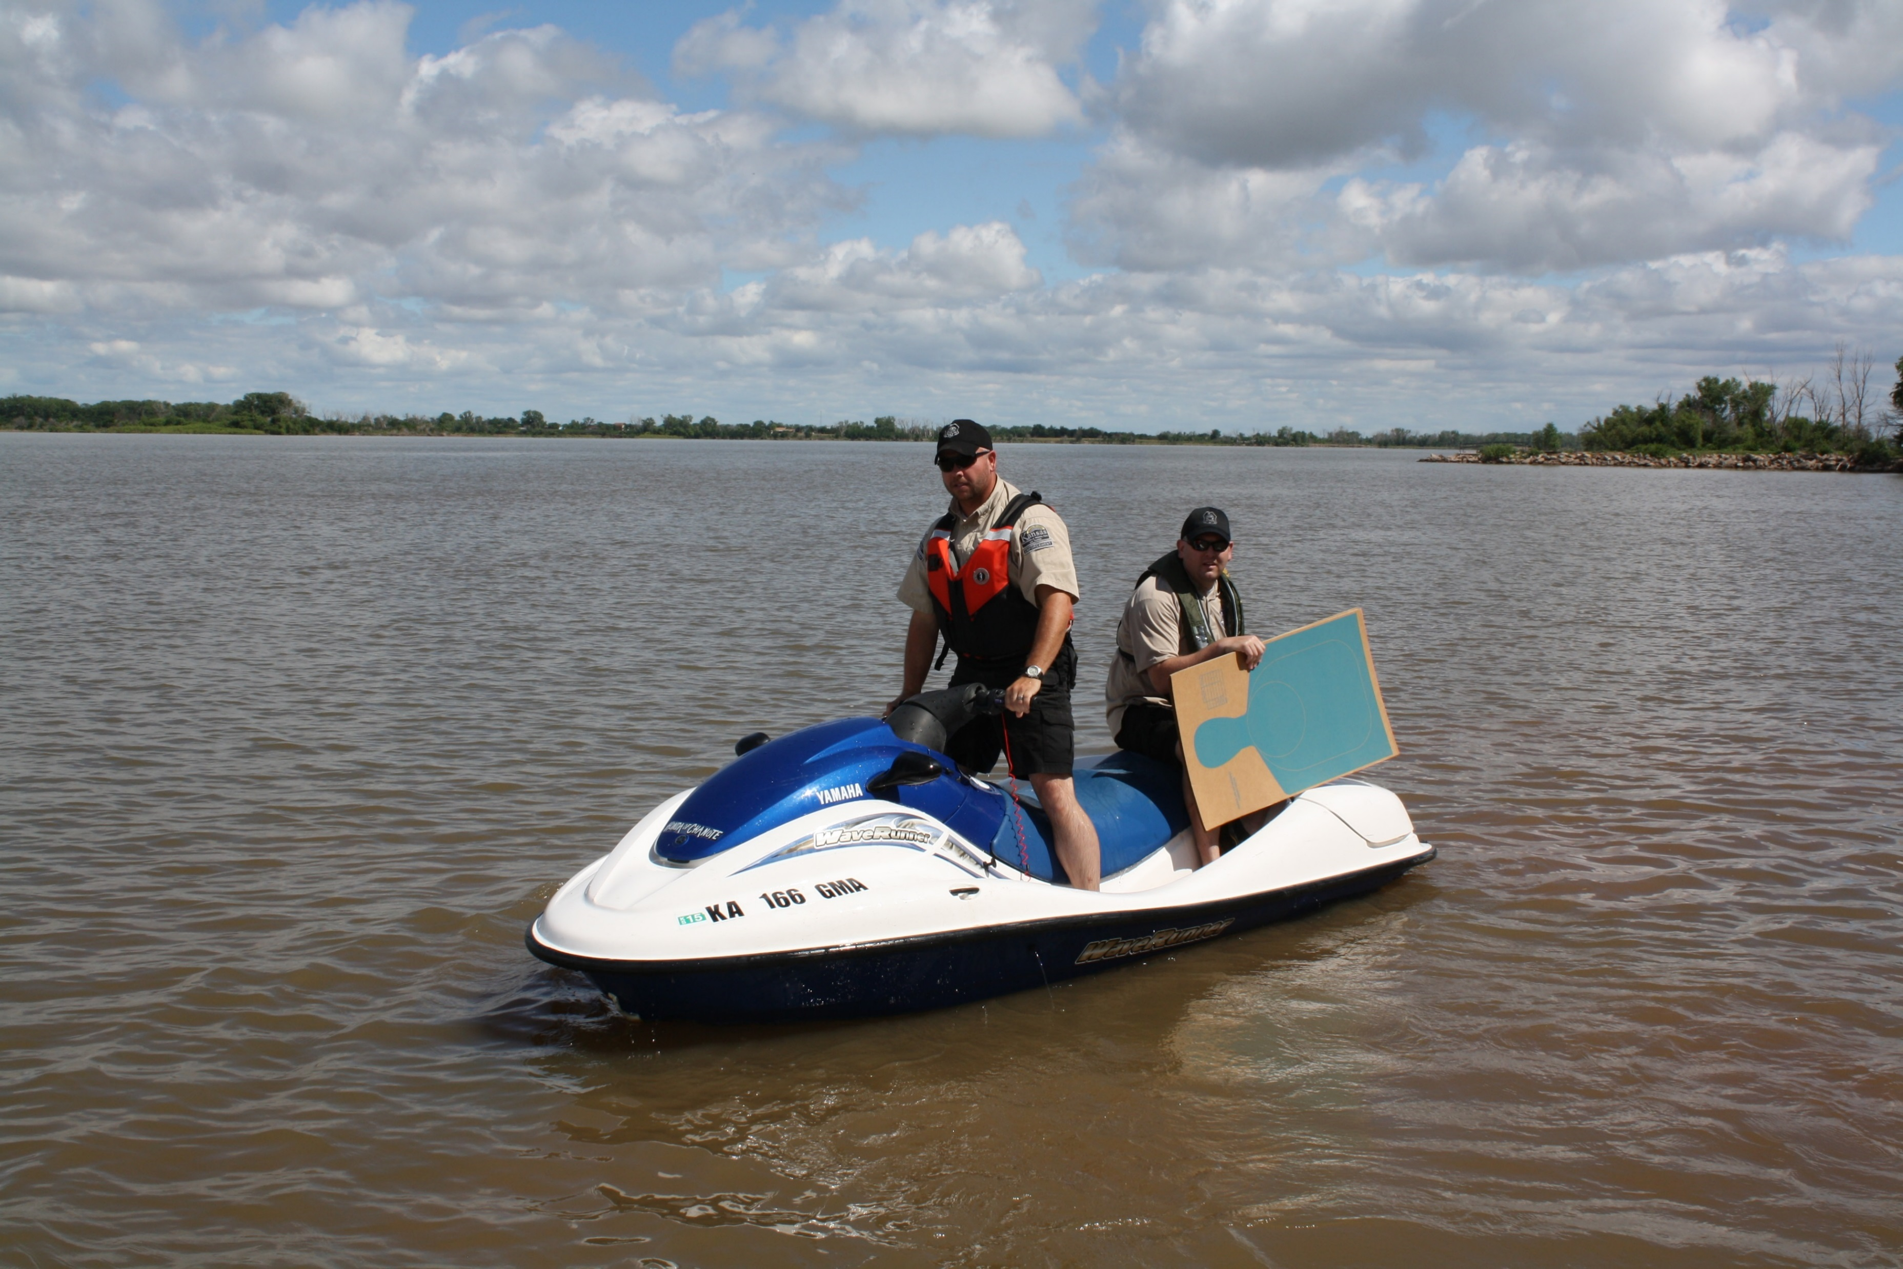
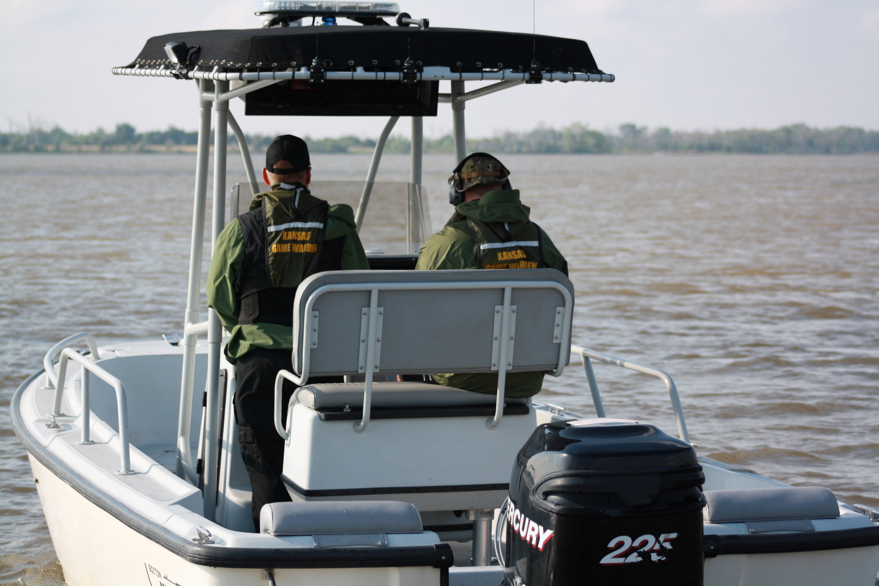
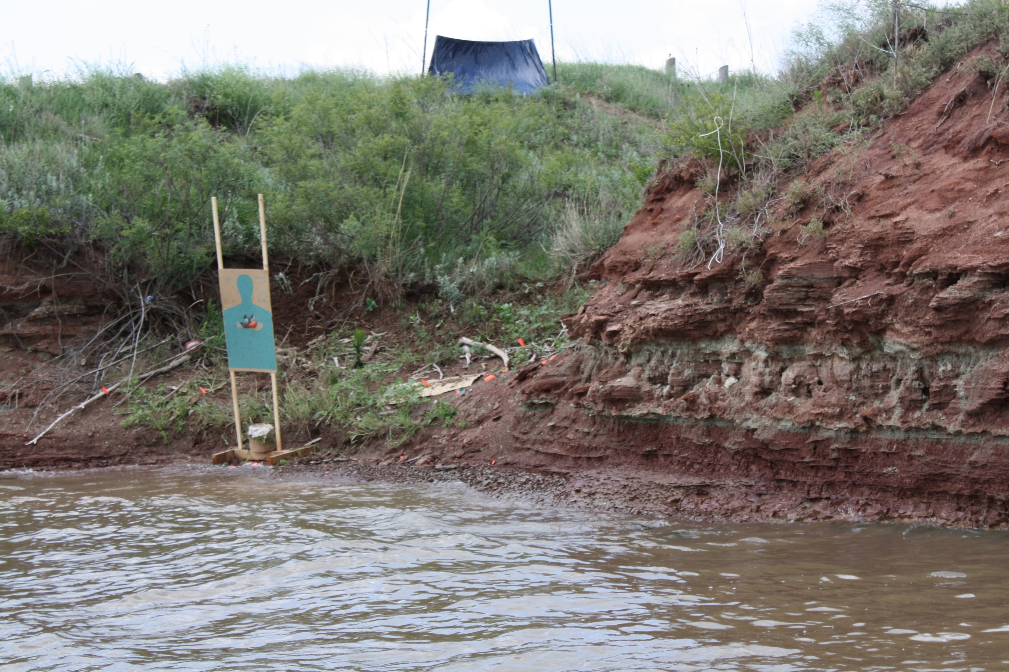
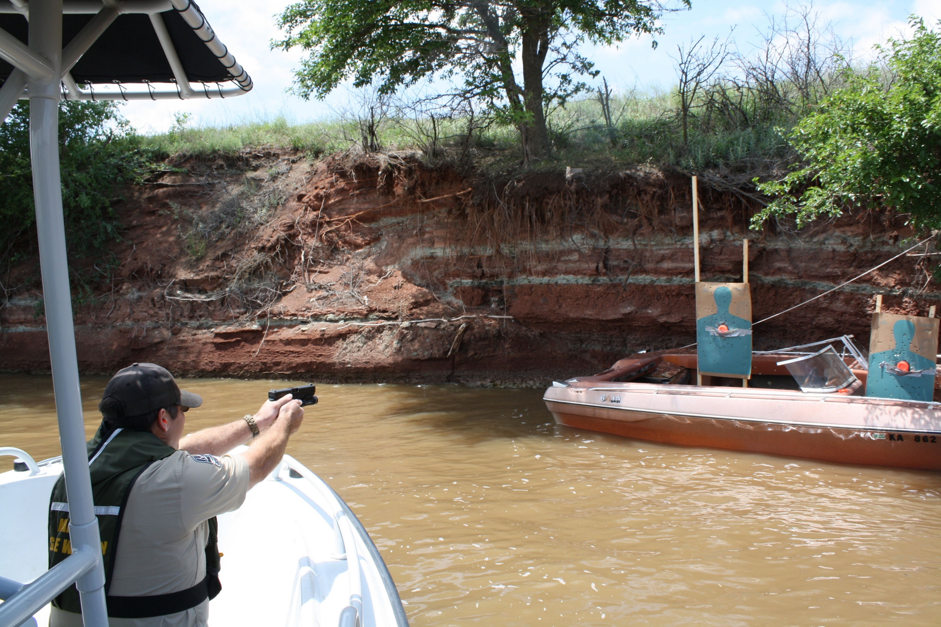
WHAT RESOURCES DO YOU NEED?
PWC’S TO SHUTTLE EQUIPMENT
RESET TARGETS
7 STATIONS = 7 PWC’S
2 PWC’S FOR SECURING COURSE FROM PUBLIC
2 PATROL BOATS TO RUN THE COURSE AND ONE SPARE
1 STAGING BOAT
1 SAFETY AND CONTROL BOAT
CARD BOARD TARGETS
PEPPER POPPERS
AUTOMATED TARGETS
MARKERS/BLUE ROCK
WEIGHTS, STAKES, TAPE, STAPLES, ETC.
TARGET BOATS
RIGGINGS TO SECURE TARGETS
ANCHORS AND ROPES TO SECURE BOATS FROM WAKES
ENOUGH WATER DEPTH TO GET IN CLOSE
Notes:
DON’T FORGET THE LITTLE THINGS, SUNSCREEN, HEADACHES, EYES, EARS,

Slide 19
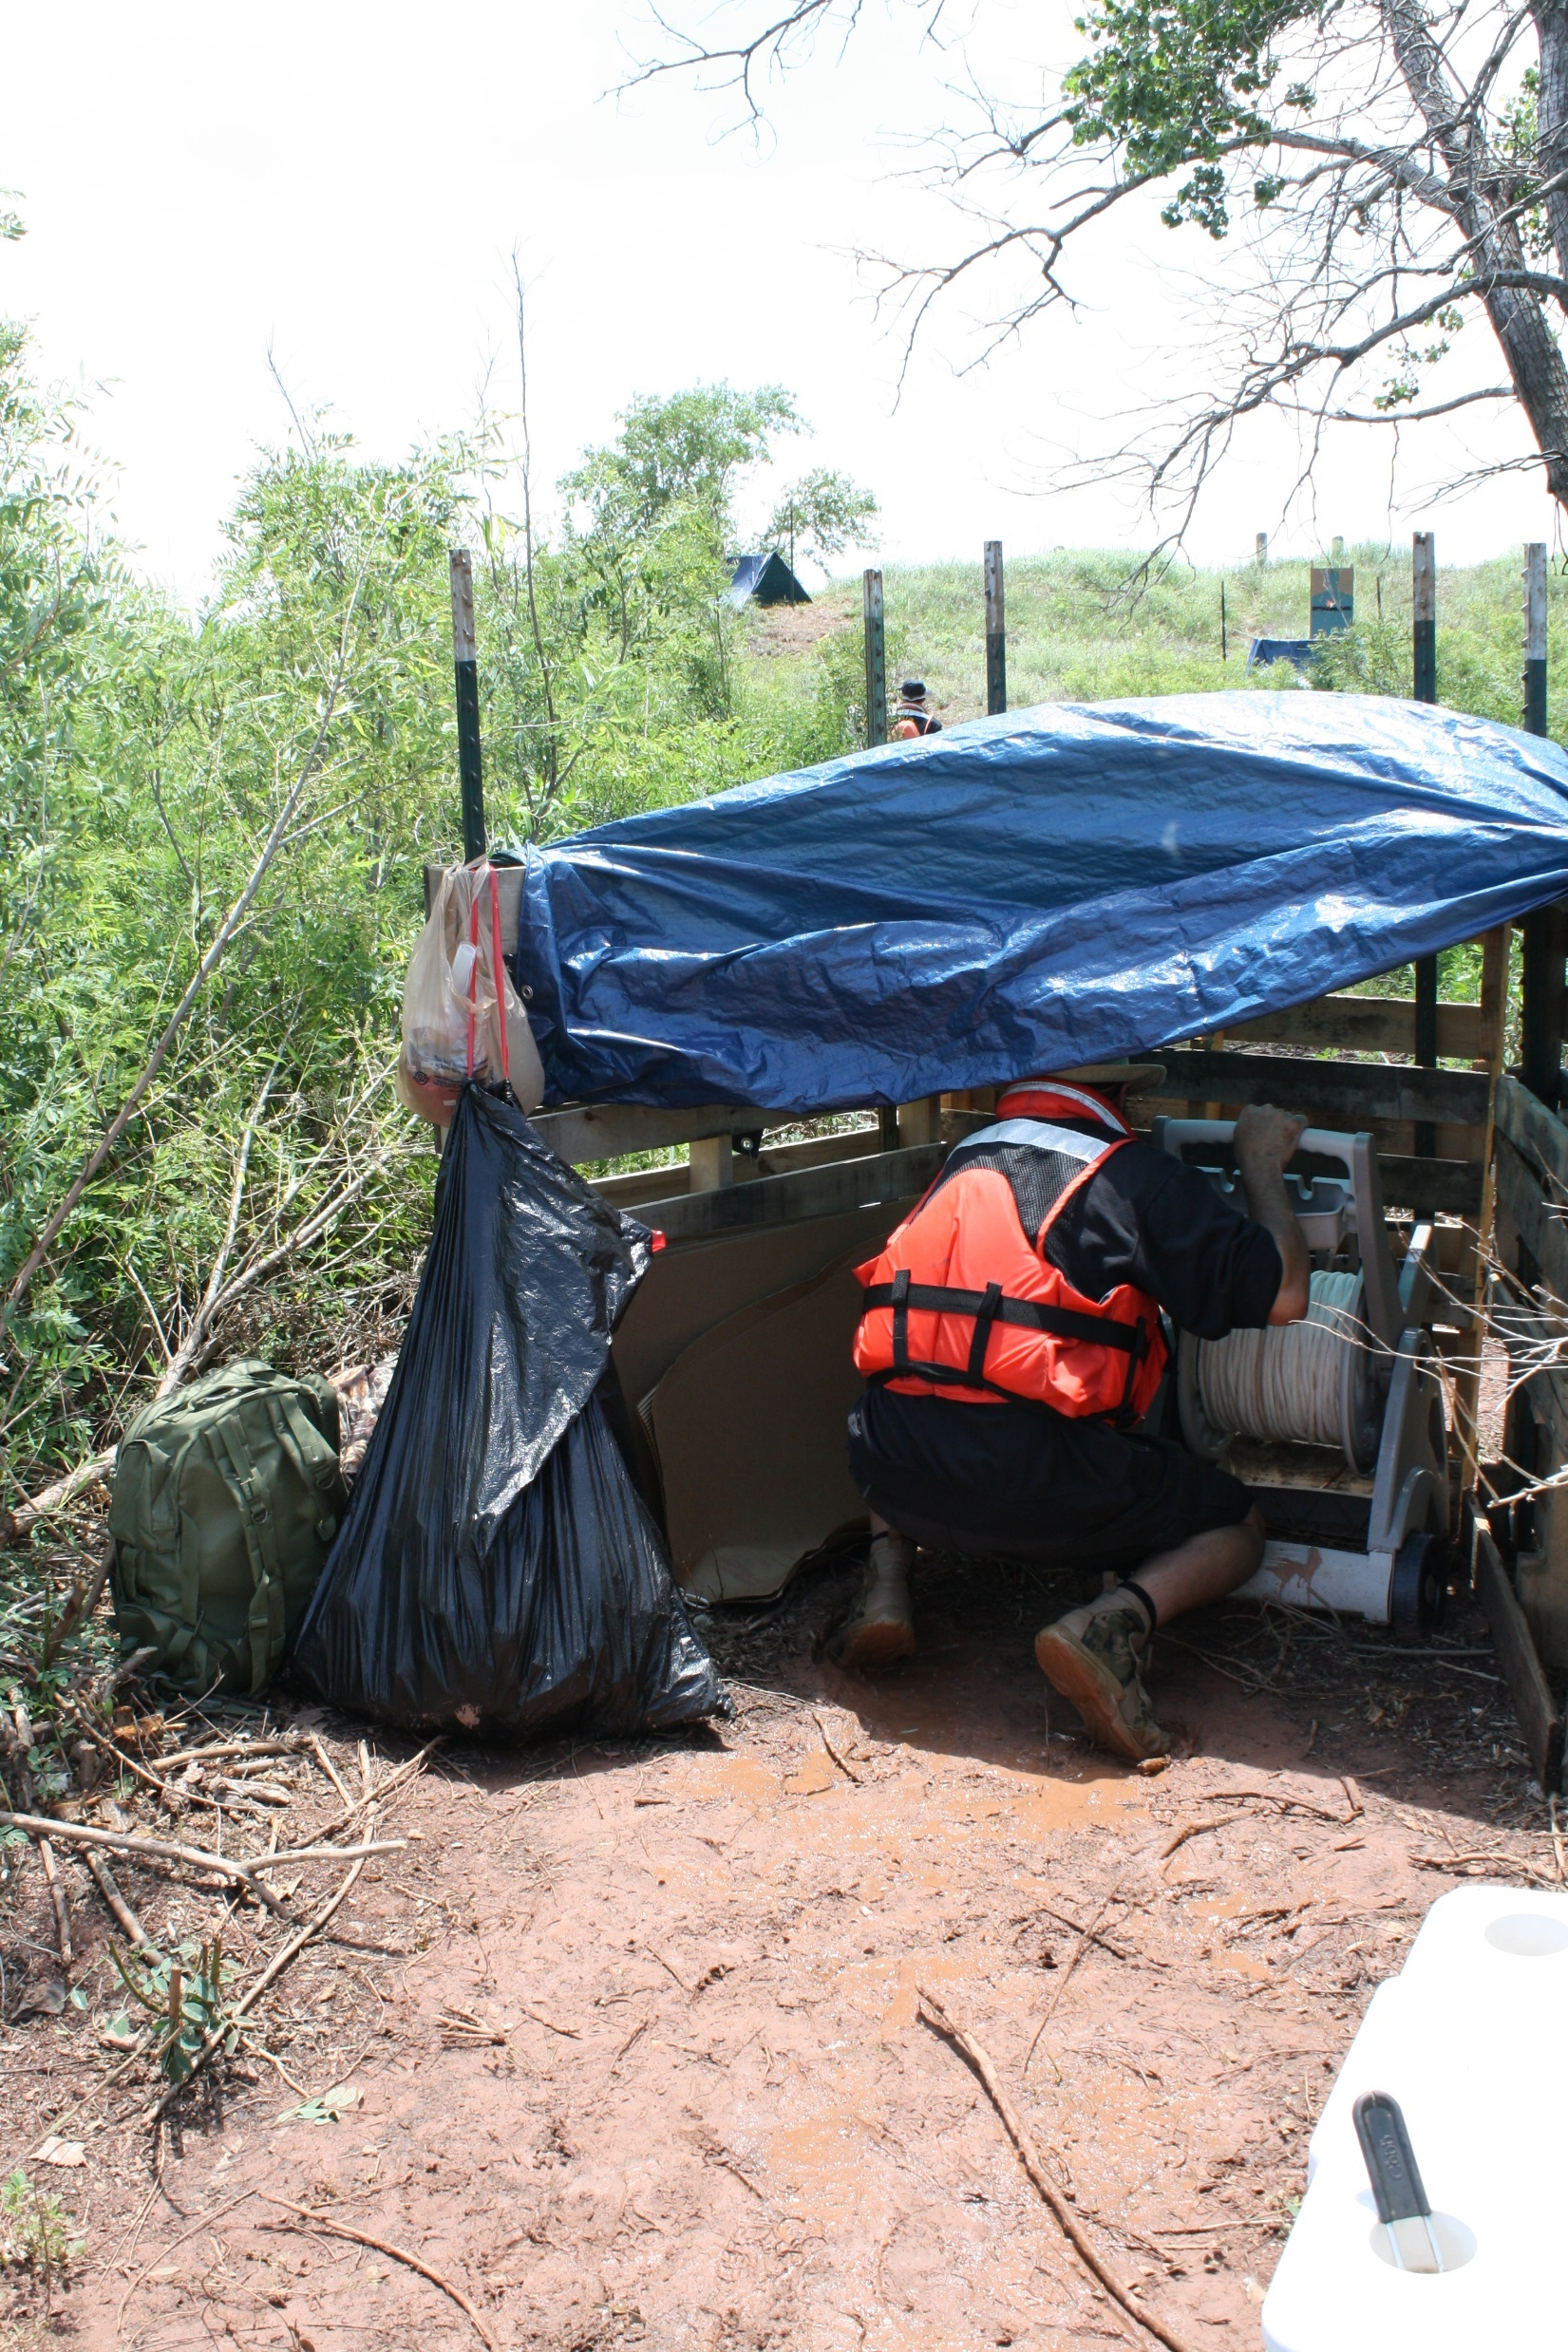
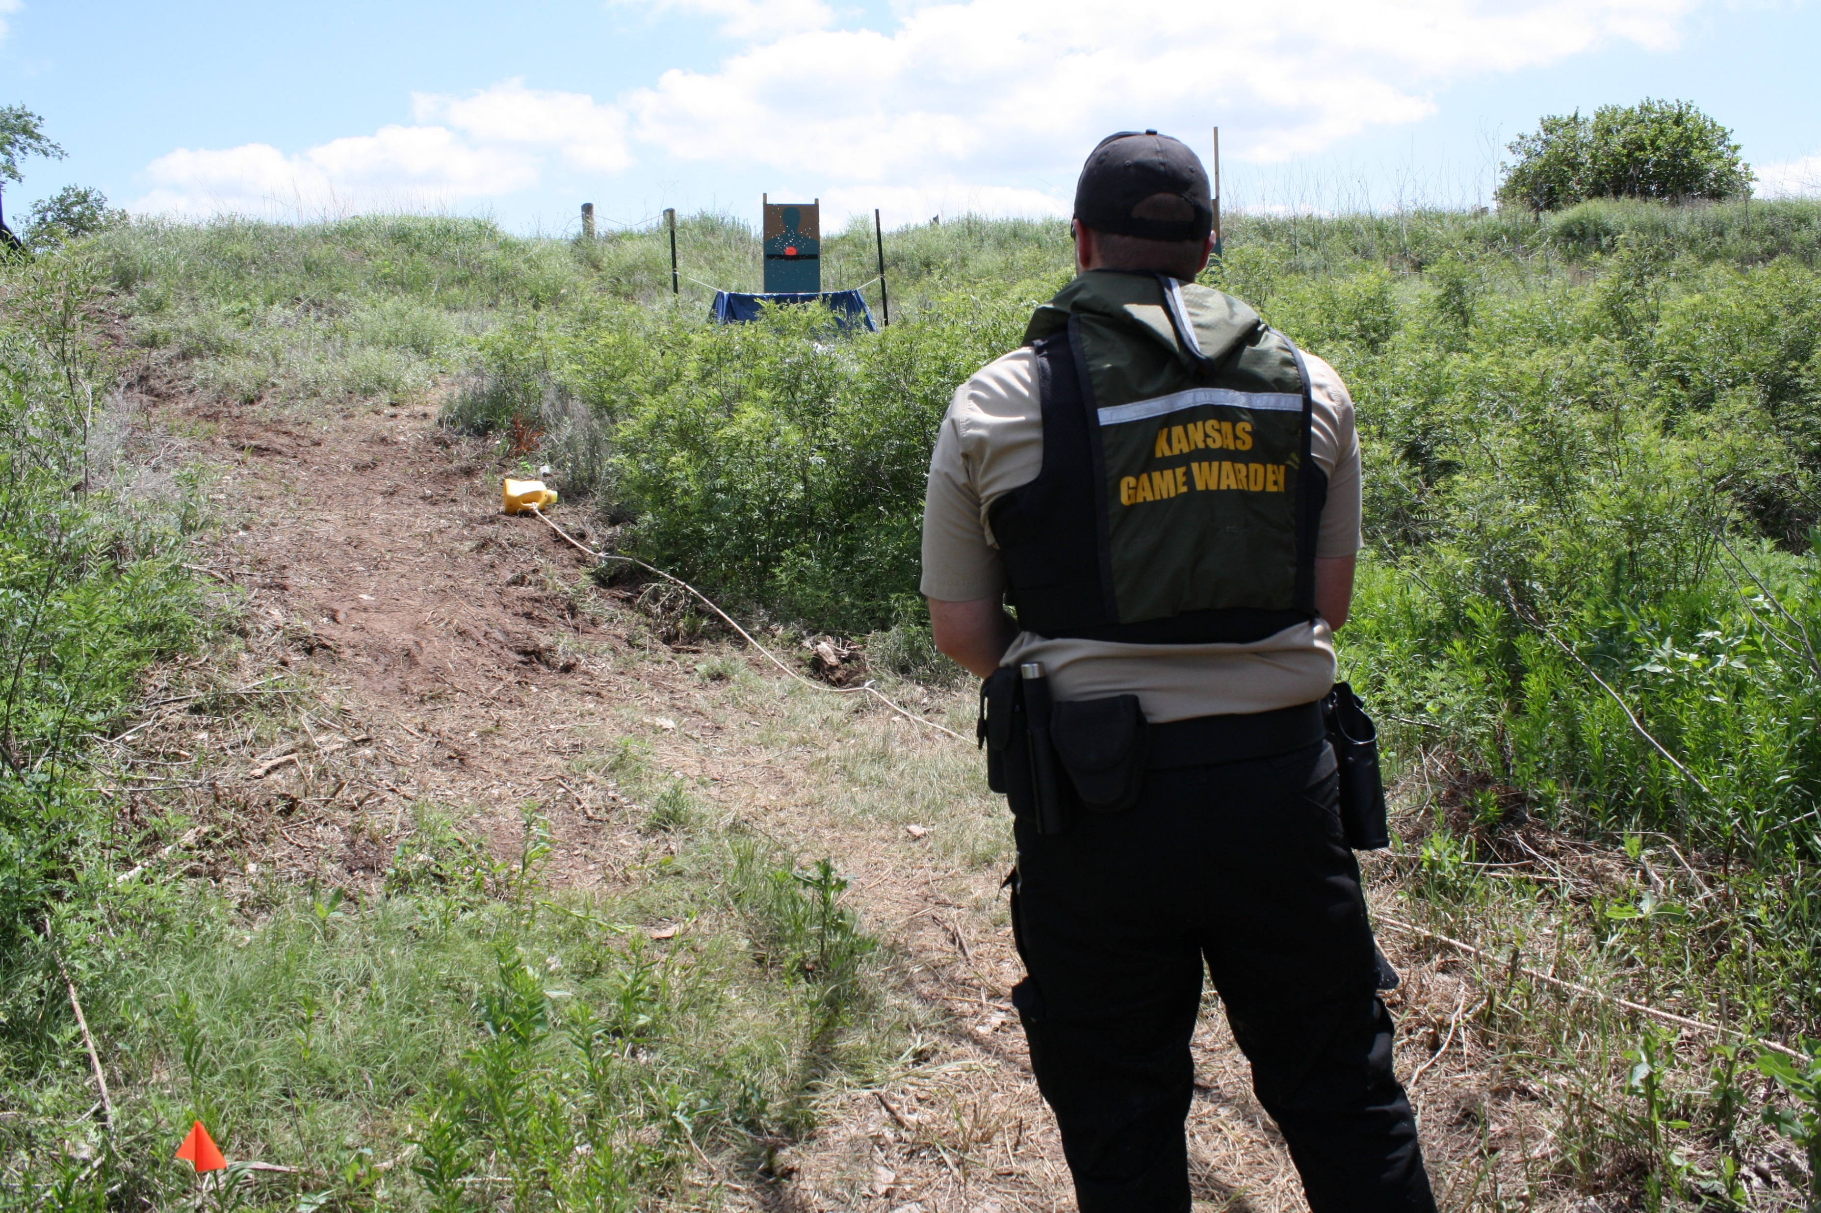
THE RUNNING DOG
SPECIALIZED STATIONS

Slide 20
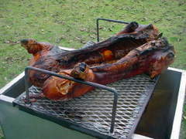
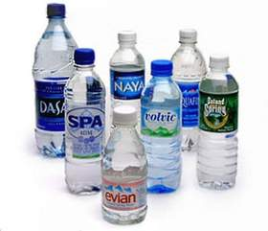
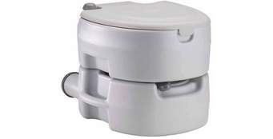
DON’T FORGET THE IMPORTANCE OF THE NECESSARY REQUIREMENTS FOR YOUR OFFICERS

Slide 21
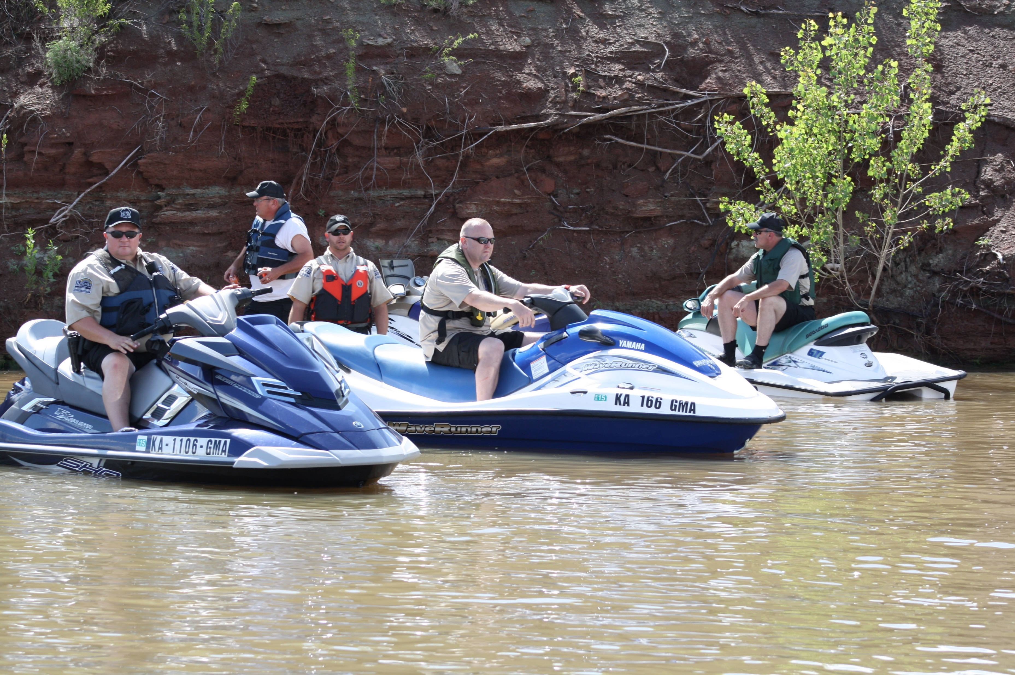

OFFICER TIME WILL BE VERY IMPORTANT TO MONITOR ESPECIALLY THOSE ASSISTING WITH THE TRAINING

Slide 22

KEEP THE PUBLIC INFORMED
WAY IN ADVANCE, ADVISE THE PUBLIC OF ROAD AND AREA CLOSURES
WHAT IS GOING TO OCCUR
PROMOTE MEDIA COVERAGE OF THE EVENT
MOST CITIZENS ARE UNAWARE OF WHY WE TRAIN AND WHAT IT IS WE ARE TRAINING FOR.

Slide 23
DEVELOP THE LESSON PLANS AND TRAINING OUTLINES
Module | Subject Areas
1.0 | Introduction to the Marine Tactical Course
2.0 | Understanding Supporting Knowledge to Policy and Guidelines involving the Use of Force.
2.1 | Discussion of Use of Force Policy between represented states.
2.2 | Identification of threats where use of force may be required and course of actions to be taken.
2.3 | Discussion of cover and concealment on a patrol vessel.
2.4 | Demonstration of use of force and cover/concealment during practical exercises.
3.0 | Practical exercise activities involving multiple scenarios where the student will demonstrate the proper technique in the discharge of a firearm towards a threatening target.
4.0 | Students shall critique their performance and give feedback to the officers relating to the course of fire.

Slide 24
Outline For In-classroom Instruction:
Vicarious Liability Issues:
Negligent Training
Negligent Retention
Negligent Hiring
Negligent Supervision
Failure to Disclose-Did not inform another agency about employee records when asked.
Training Concerns:

Slide 25
Notes:
READ RANGE RULES TO EACH GROUP AGAIN AT THE SITE – SAFETY SAFETY SAFETY,

Slide 26
MarTac Courses of Fire
Station 1: Shoreline (siderarm 1X5 = 5 rounds)
Enter course with vessel on plane.
Bring vessel to a COMPLETE stop with the bow away from the targets.
Using motor/engine as cover, engage 5 paper targets located on the shoreline at a range of approx. 15 yrds.
Fire one (1) round at center mass per target.
A mandatory magazine change is required prior to engaging targets at Station Two.
Secure weapon and collect spent magazines.

Slide 27
Notes:
REACTIVE TARGETS WOULD BE ABLE TO SHOOT COURSE AS IF OFFICERS CARRY.

Slide 28
Station 2: Boarding (sidearm X 5 = 5 rounds)
Maneuver vessel along-side the contact vessel.
Conduct “routine” boarding with instructor providing voice of contact vessel operator.
During contact, instructor gives command “gun”
Engage two (2) paper targets in contact vessel at distance of approximately 5-7 yards.
Fire two (2) rounds center of mass per target with shooters choice of one (1) head shot in either target.
Secure weapon.

Slide 29
Notes:
OKLAHOMA BUILT MOST OF THEIR REACTIVE TARGETS, SIMULATED AUTOMATIC MACHINE GUN FIRE; CREATES THE OH CRAP FACTOR

Slide 30
Station 3: Shoreline [shotgun (buckshot 1 x 3 = 3 rds and slug 1 x 2 = 2 rds.)]
Maneuver vessel counterclockwise around a central buoy and stop at a designated location.
Engage five (5) Dozier targets on shoreline from high kneeling position at a distance of 40-50 yards.
Fire three (3) rounds .00 Buckshot at closest three targets.
Combat load two (2) rounds of slugs.
Fire two (2) rounds of slugs at the last 2 targets.
Secure an empty weapon.

Slide 32
Station 4: Shoreline (rifle 5 X 1 = 5)
Maneuver vessel on course with bow away from targets.
Bring vessel to complete stop prior to engaging targets.
Using motor/engine for cover engage single target on shoreline at a distance of 50 – 75 yards.
Fire 5 rounds at center mass.
Secure an empty weapon.
Exit course if directed.

Slide 34
Station 5 or alternate:
Exiting vessel to campsite on call of domestic disturbance (sidearm 12 X 1 = 12)
Before entering into the station run, the student officer will be informed by the instructor that they are responding to a domestic disturbance occurring on shore at a campsite where possible weapons are involved and a mean dog.
Maneuver the vessel to a designated landing zone on shore and secure the vessel.
The student shall exit the vessel and upon command by the instructor shall proceed to a contact point with the campground.
Upon the threat command by the instructor the student will have to identify one of two targets as the threat and fire 4 rounds center mass to stop the threat.
Upon completion of 4 rounds center mass to the human threat, the instructor will give the command of dog.
After the threat of dog is given, a vicious dog (detergent bottle or bucket) will be maneuvered towards the officer.
The officer shall engage the target with their remaining rounds.
Secure an empty weapon.
Re-board the patrol vessel.
Exit the course or continue onto the next station as directed.
Notes:
GIVE CREDIT TO OFFICER INGENUITY; ASP ON THE DOG.

Slide 36
Station 6 and/or alternate: Active shooter (rifle 30 X 1 = 30)
This station may be performed with one active shooter target based on shore or on a floating vessel/platform.
Course vessel will return to staging buoy before given the information that they will be responding to an active shooter located near shore in a campsite. Several victims are down and his job is to take the shooter out, or distract him to stop the aggressive threat.
Instructor will go over the bracing technique for the officer to engage using his M-4 rifle and the T-top configuration of the console for support shooting from a mobile patrol vessel with accuracy.
When the vessel is given clearance from the staging vessel, the operator of the patrol vessel shall maneuver the patrol vessel on plane to the outer course buoy.
Upon maneuvering the patrol vessel around the course
Buoy; the student shall engage the target when the vessel operator brings the vessel into a position where the student can get a clear view.
Vessel operator shall maneuver the vessel where the student can obtain target acquisition at approximately 75 to 100 yards and maintain the course until the 30 round magazine is spent, or the course vessel reaches the shutdown buoy.
Notes:
ACTIVE SHOOTER; NOT TO DISCHARGE FOR FUN, TAKING OUT THE TARGET, REACTIVE TARGET WORKS THE BEST.

Slide 38
Sidearm: Station 1 (5 rounds) X 2 = 10 rounds.
Sidearm: Station 2 (5 rounds per boat X 2 = 10) X 2 = 20 rounds.
Sidearm: Station 5 (12 rounds) X 2 = 24 rounds.
Shotgun: Station 3 .00 Buck (3 rounds) X 2 = 6 rounds.
Slug Rounds (2 rounds) X 2 = 4 rounds.
Rifle (.223): Station 4 (5 rounds) X 2 = 10 rounds.
Rifle (.223): Station 6 (30 rounds) X 2 = 60 rounds.
Total per officer:
Sidearm = 54 rounds
Shotgun slug = 4 rounds
Shotgun .00 Buck = 6 rounds
Rifle (.223) = 70 rounds

Slide 39
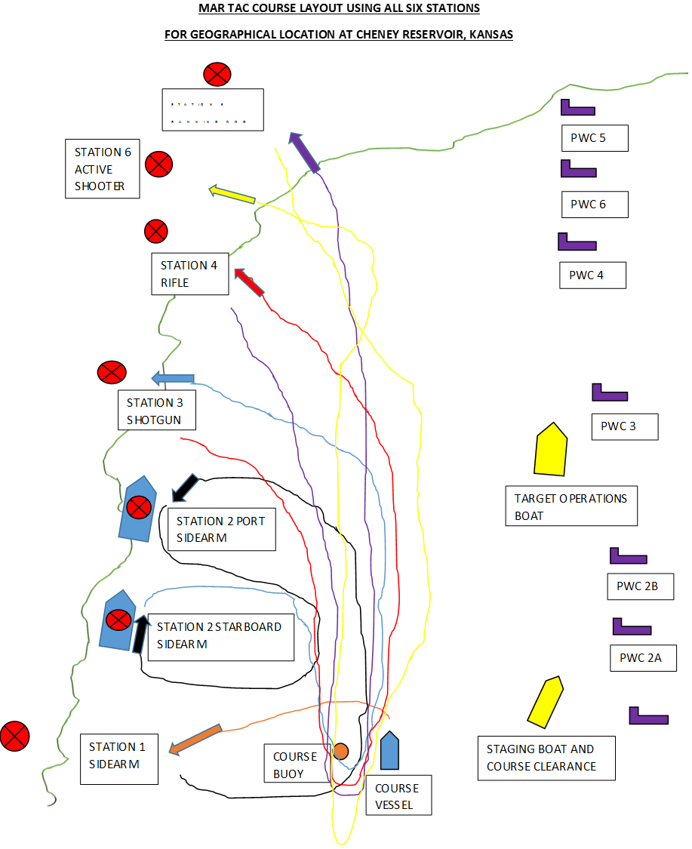

Slide 40
